Slide 1





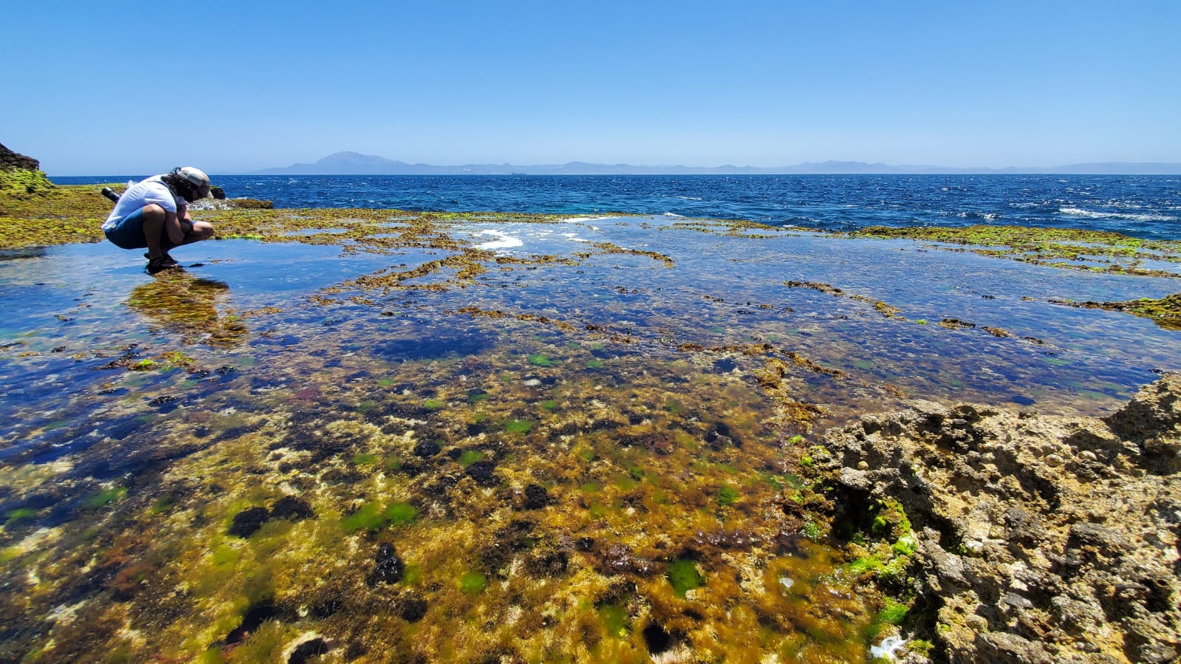
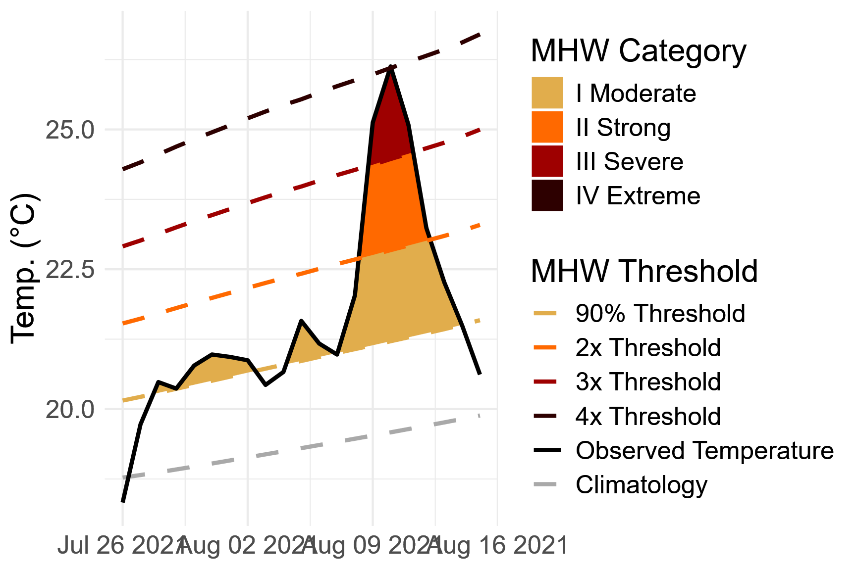
FORECASTING THE IMPACTS OF MARINE HEATWAVES ON HABITAT-FORMING INVERTEBRATE SPECIES
Andrew R. Villeneuve¹, Easton R. White¹
1Department of Biological Sciences, University of New Hampshire, USA
One Ocean Science Congress
4 June 2025Marine Biodiversity Observation and Monitoring - Session T3-6
1

Slide 2
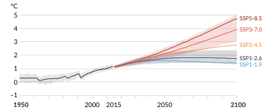



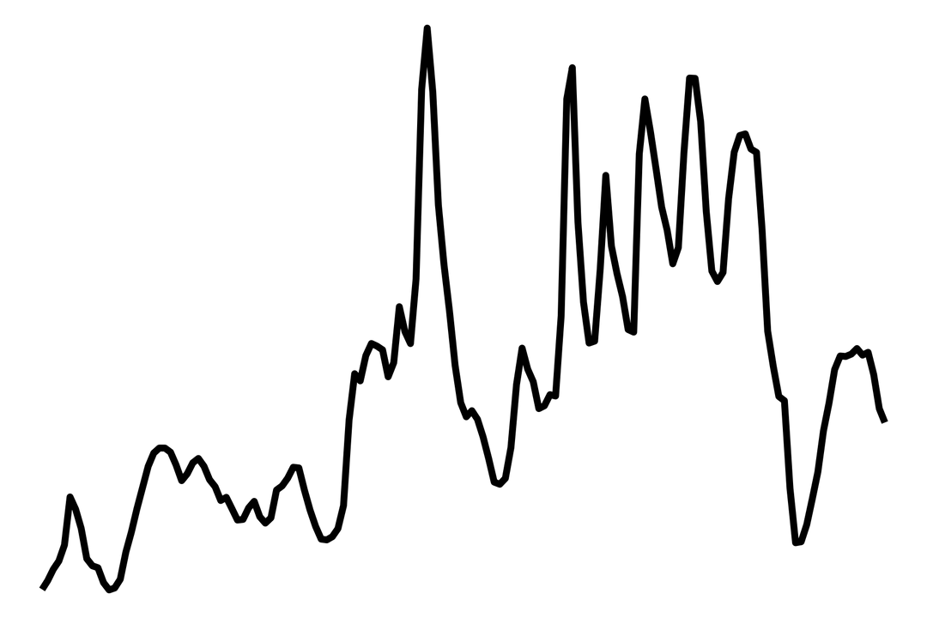

Predicting Biodiversity under a variable future
Climate change is pushing global mean temperature upwards over decadal scales.
Jentsch et al. 2007, van de Pol et al. 2017, Latimer and Zuckerberg 2019, Jackson et al. 2021, IPCC 2021 (PC).
We see extreme temperature events happening on much quicker time scales – pulses occurring
minutes to months.
IPCC RCP Global mean temperature projections
This variability is over the scale at which many animals operate!
2
Notes:
zoom in animation

Slide 3

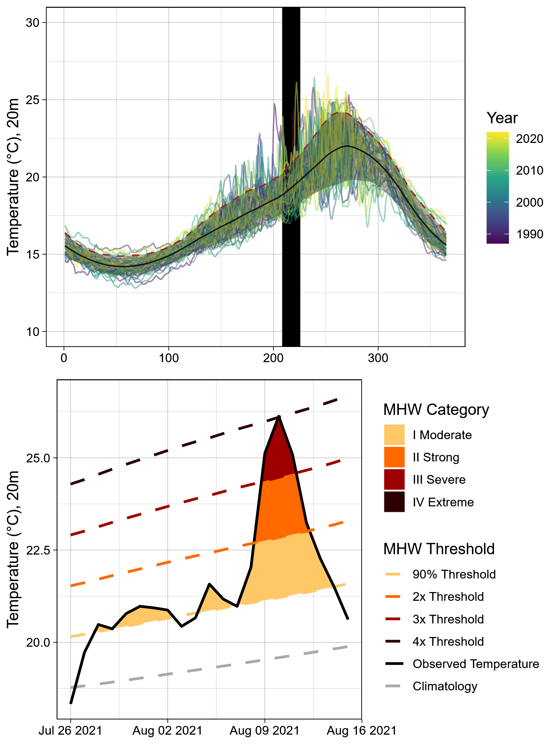
Marine Heatwaves (MHWs)
Extreme events occurring in the marine systems, driven by oceanic and atmospheric processes.
How to define? One approach – statistical analysis of historic temperatures.
Day of Year
Temperature exceeds 90th percentile of 30-year historical time series
Describes what is extreme for a given location - but is this what is extreme for organisms?
3
Hobday et al. 2016; 2018

Slide 4
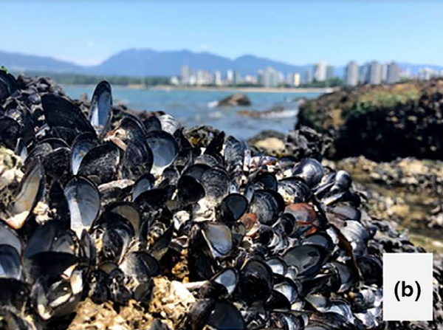
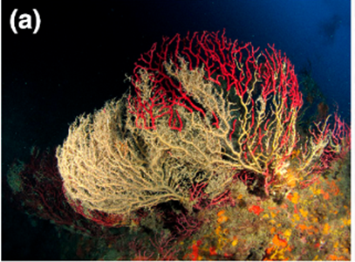
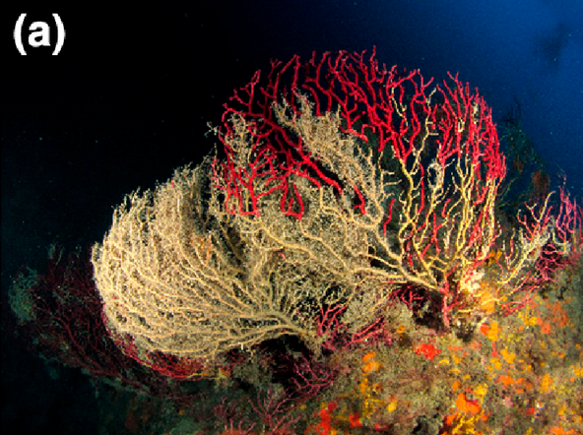
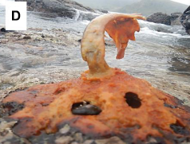
The ultimate ecological impact: Mass Mortaltiy Events
Intertidal Bivalves, Salish Sea, US and Canada, 2021
Subtidal Gorgonians, Mediterranean Sea, 2003 & 2018
Intertidal Kelp, New Zealand, 2018
Raymond et al. 2022
Garrabou et al. 2022
Thomsen et al. 2019
Forecasting Goals: 1) Predict when conditions cause mass mortality events,
and 2) what the extent of damage resulting from these events
4

Slide 5










Complex Links
Statistical Lens
Biological Lens
Duration
Magnitude
Seasonal Timing
Ramp Rate
Survival
...many other time series metrics
Time
6

Slide 6
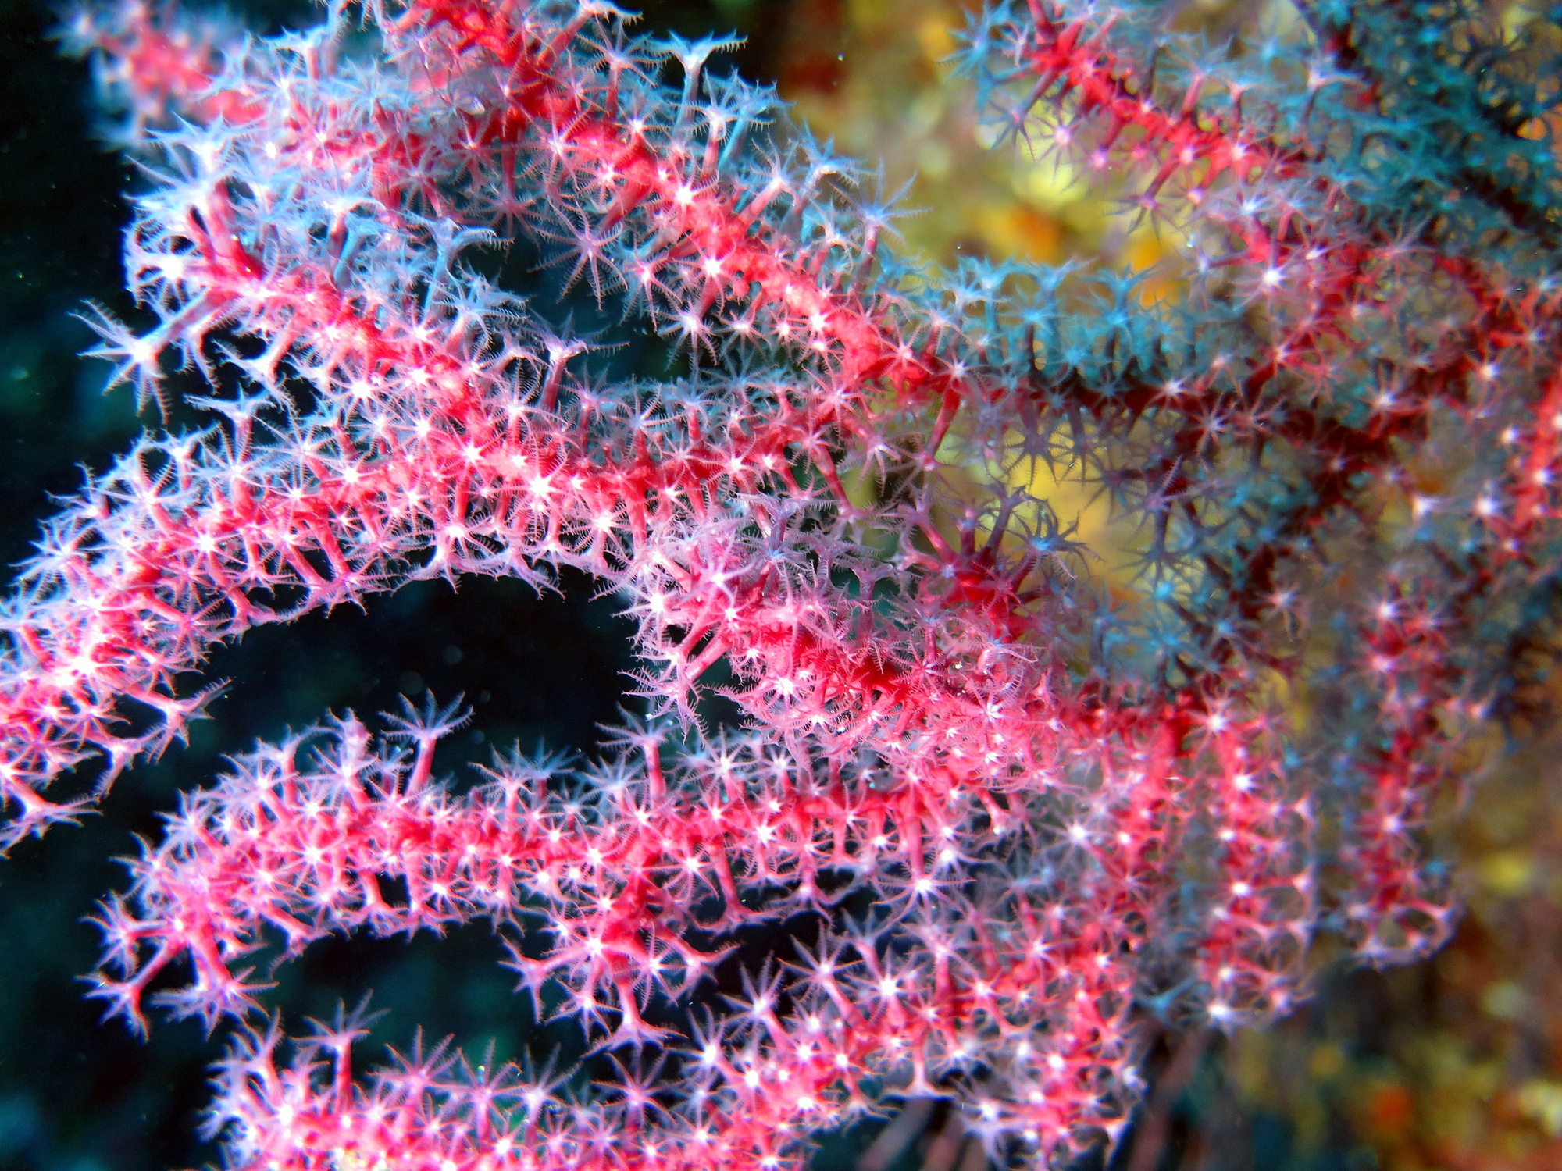
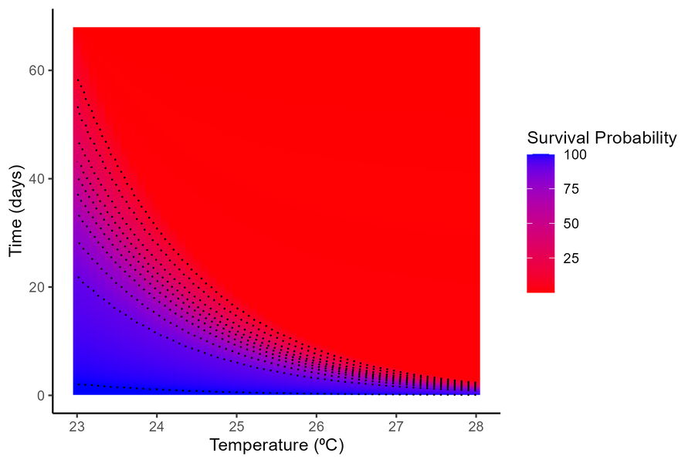
A Biological Approach: Thermal Tolerance Landscapes
Important to consider exposure duration when measuring thermal tolerance - temperature as a dose.
Time to death follows a log-linear pattern across taxa.
Create a continuous landscape of survival probability
We constructed a TTL for the gorgonian Paramuricea clavata
Rezende et al. 2014, Pairaud et al. 2014, Gomez-Gras et al. 2021
7
Notes:
Remove tdt and simplify

Slide 7
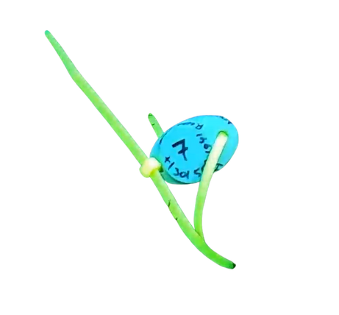

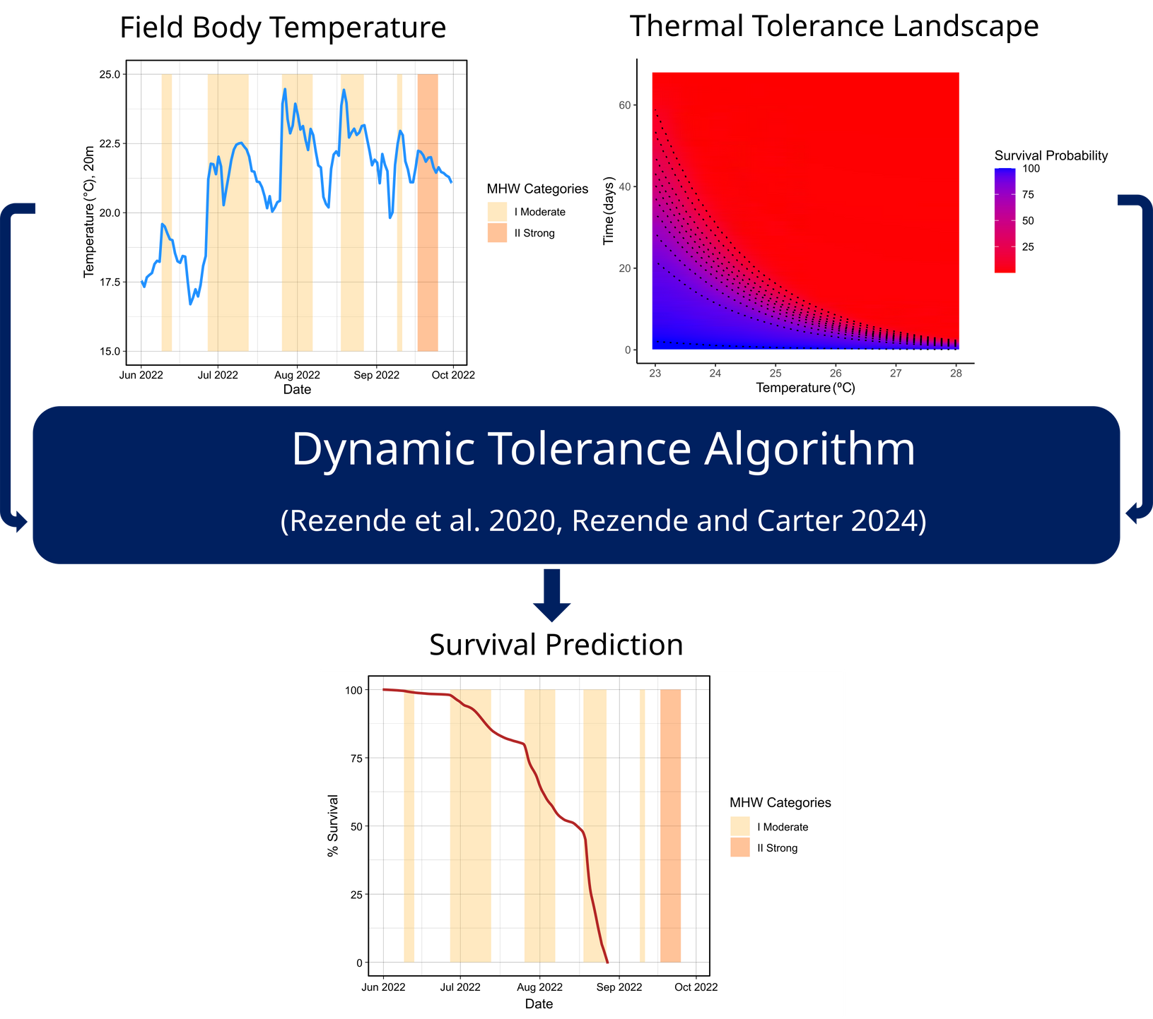
A Biological
Approach: From
Model to Prediction
Rezende et al. 2020, Villeneuve and White 2024
8
Notes:
We treat the gorgonian as a processing unit of a heatwave, and replicate how the gorgonians process heat stress using a dynamic tolerance algorithm. The output of this algorithm is a prediction of survival probability through time.

Slide 8
Case Study: Paramuricea clavata in the western Mediterannean
1
Does P. clavata mass mortality severity follow MHW severity?
2
Are forecasts made by thermal tolerance landscapes accurate?
9

Slide 9
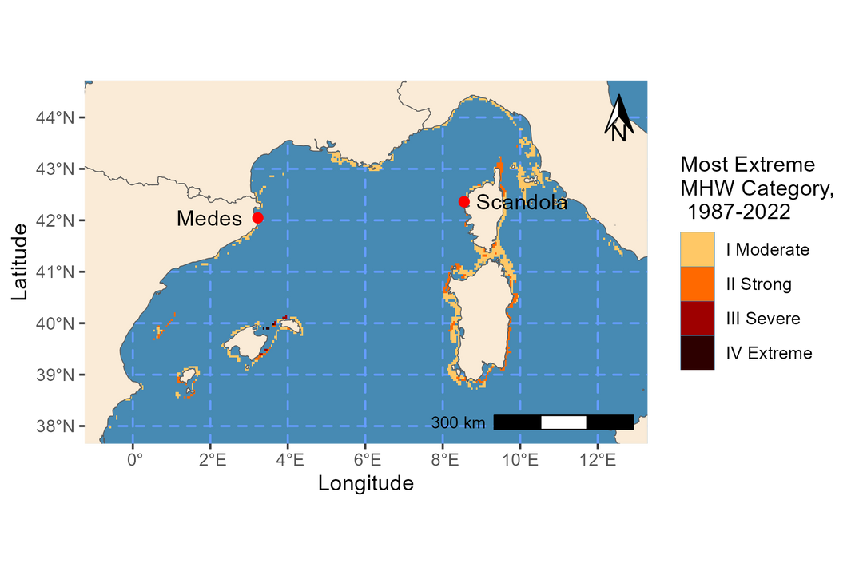
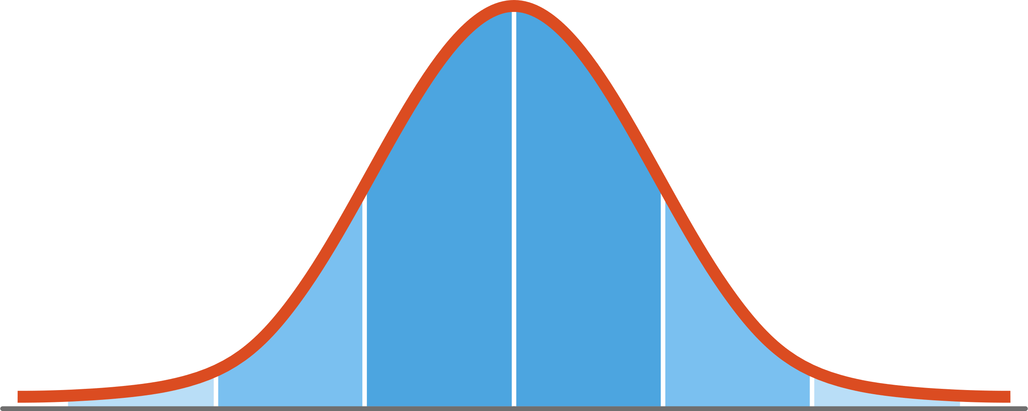
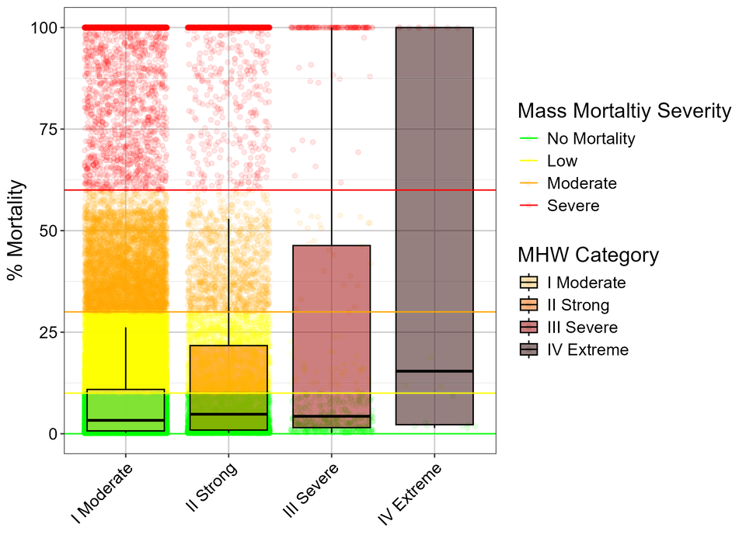
Statistical MHWs do not describe Mass Mortality Event Severity
Method:
We modeled mortality of P. clavata across the western Mediterranean between 1987 and 2022 using remote-sensed water temperature at 20m.
Result:
Little overlap between statistical and biological categories of severity
Statistical MHW Analysis
TTL Approach
10

Slide 10
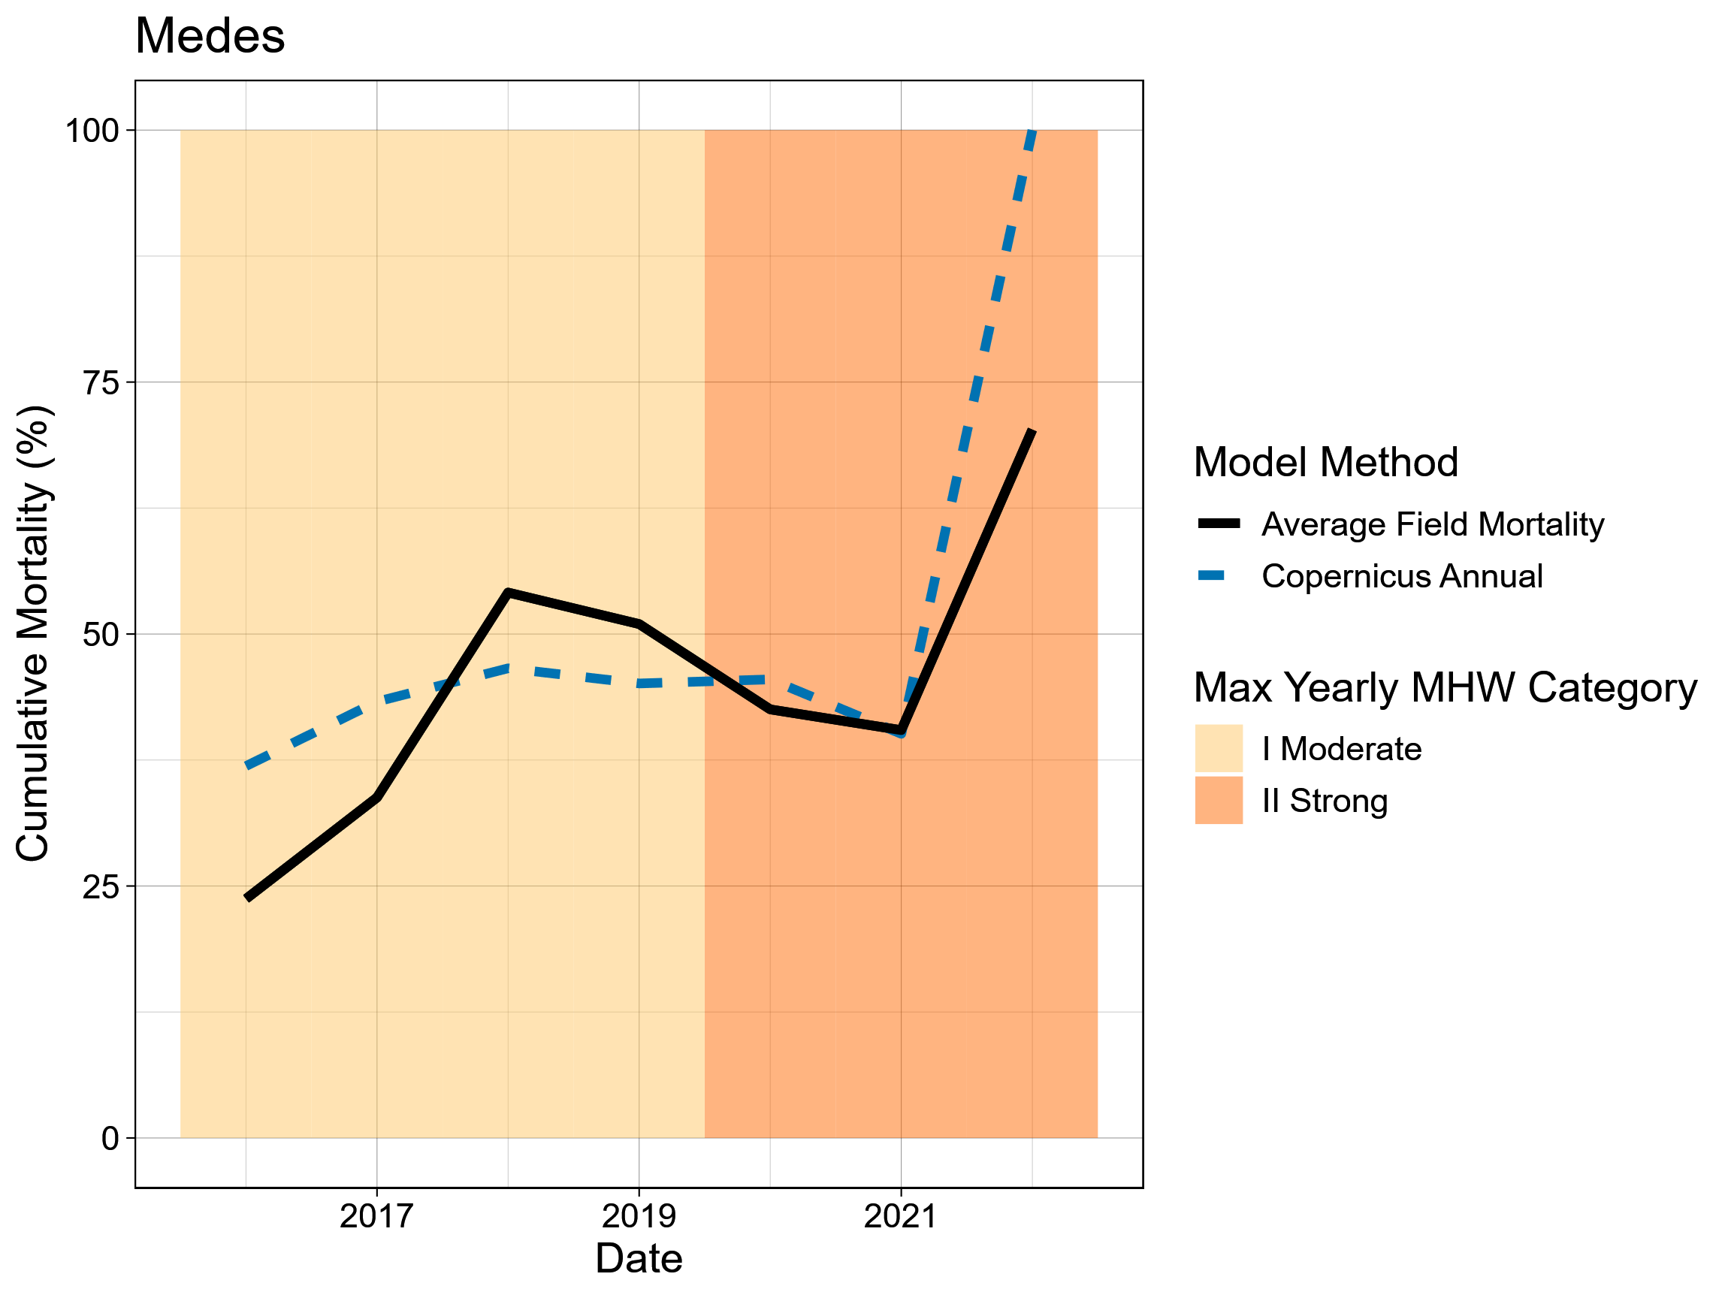
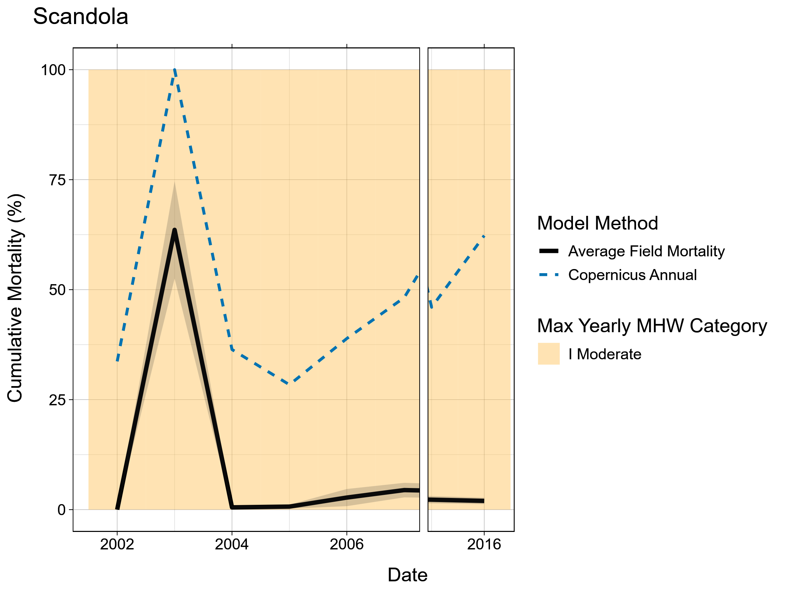
Modeled Mass Mortality matches field mortaltiy at some sites
Method
We compared observed field mortality at Medes Islands, ES, and Scandola MPA, FR against modeled mortality.
Result
Good fit of modeled and observed survival at Medes. Local adaptation may be responsible for overprediction at Scandola.
Rovira et al. 2024, Gómez-Gras et al. 2021
11
Notes:
Field vs. model mortality

Slide 11
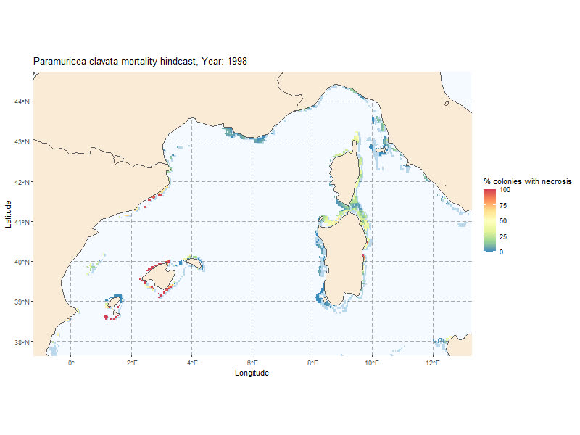



Towards Operational Forecasts of Extreme Event Impacts
Models that use time provide better predictions
Remote monitoring of hard-to-survey areas
Oceanographic forecasts can yield mortality forecasts
12
Notes:
simplify

Slide 12

Key Takeaways
Environment
Biology
Extreme event extremity from an organismal perspective
Ecologically
relevant
temperature
Time-integrated
physiological
performance
13

Slide 13

Acknowledgements
We thank Pol Capdevila, Laura Figuerola-Fernando, Joaquim Garrabou, Daniel Gómz-Gras, and Cristina Linares for their input and access to data.
Contact and Website
Funding
ARV is funded by the University of New Hampshire Dissertation Year Fellowship and New Hampshire Sea Grant Graduate Fellowship. OOS travel generously provided through the FADEX program through the Embassy of France in the United States.
ARV and ERW supported by New Hampshire Agricultural Experiment Station, USDA National Institute of Food and Agriculture Hatch Project 7005066 and the state of New Hampshire.
villesci.github.io
drew.villeneuve@unh.edu
Bibliography
14

